Slide 1
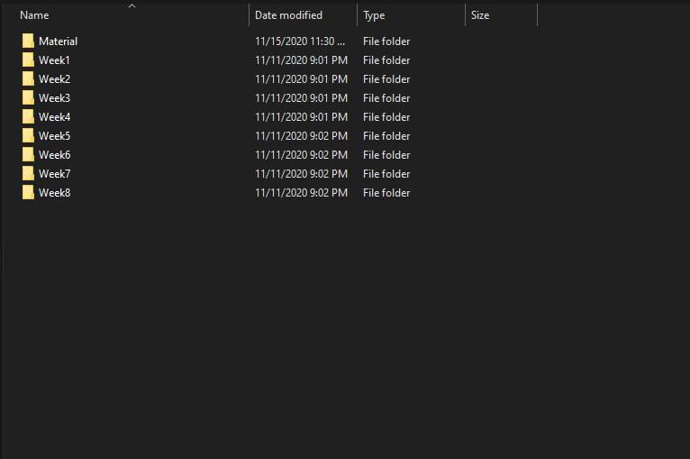

Slide 2
Provide all data

Slide 3
HTML

Slide 4
CSS

Slide 5
Projects

Slide 6
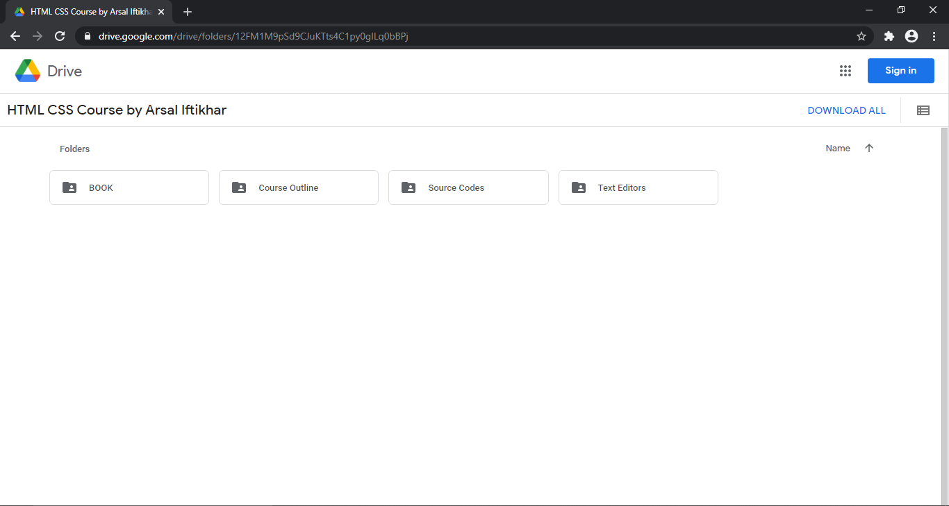
Drive link: https://drive.google.com/drive/folders/12FM1M9pSd9CJuKTts4C1py0gILq0bBPj

Slide 7
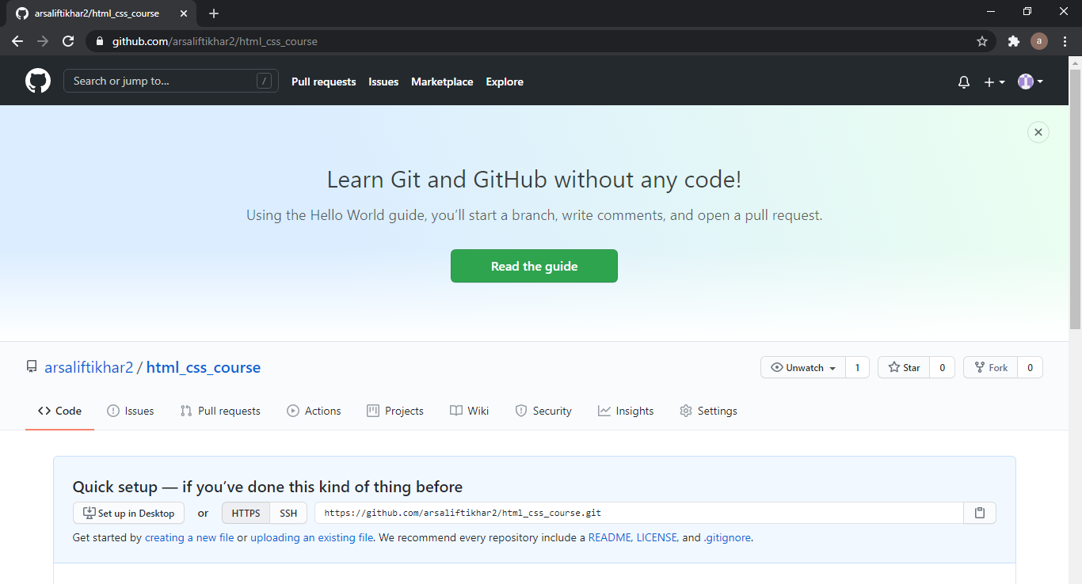
Github link: https://github.com/arsaliftikhar2/html_css_course

